Slide 1
JAVA-MULTITHREADING

Slide 2
Multithreading in Java
Multithreading in Java is a process of executing multiple threads simultaneously.
A thread is a lightweight sub-process, the smallest unit of processing. Multiprocessing and multithreading, both are used to achieve multitasking.
We use multithreading than multiprocessing because threads use a shared memory area. They don't allocate separate memory area so saves memory, and context-switching between the threads takes less time than process.
Java Multithreading is mostly used in games, animation, etc.

Slide 3
Advantages of Java Multithreading
1) It doesn't block the user because threads are independent and you can perform multiple operations at the same time.
2) You can perform many operations together, so it saves time.
3) Threads are independent, so it doesn't affect other threads if an exception occurs in a single thread.

Slide 4
Multitasking
Multitasking is a process of executing multiple tasks simultaneously. We use multitasking to utilize the CPU. Multitasking can be achieved in two ways:
1) Process-based Multitasking (Multiprocessing)
2) Thread-based Multitasking (Multithreading)

Slide 5
1) Process-based Multitasking (Multiprocessing)
Each process has an address in memory. In other words, each process allocates a separate memory area.
A process is heavyweight.
Cost of communication between the process is high.
Switching from one process to another requires some time for saving and loading registers, memory maps, updating lists, etc.

Slide 6
2) Thread-based Multitasking (Multithreading)
Threads share the same address space.
A thread is lightweight.
Cost of communication between the thread is low.
Note: At least one process is required for each thread.

Slide 7
What is Thread in java
A thread is a lightweight subprocess, the smallest unit of processing. It is a separate path of execution.
Threads are independent. If there occurs exception in one thread, it doesn't affect other threads. It uses a shared memory area.
Note: At a time one thread is executed only.

Slide 8
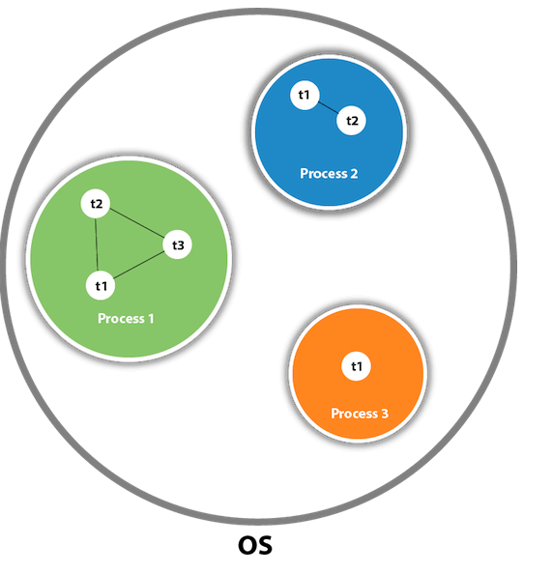
A thread is executed inside the process

Slide 9
Java Thread class
Java provides Thread class to achieve thread programming.
Thread class provides constructors and methods to create and perform operations on a thread.
Thread class extends Object class and implements Runnable interface.

Slide 10
Life cycle of a Thread (Thread States)
A thread can be in one of the five states.
According to sun, there is only 4 states in thread life cycle in java new, runnable, non-runnable and terminated. There is no running state.

Slide 11
STATES OF THREAD
But for better understanding the threads, we are explaining it in the 5 states.
The life cycle of the thread in java is controlled by JVM. The java thread states are as follows:
1) New
2) Runnable
3) Running
4) Non-Runnable (Blocked)
5) Terminated

Slide 12
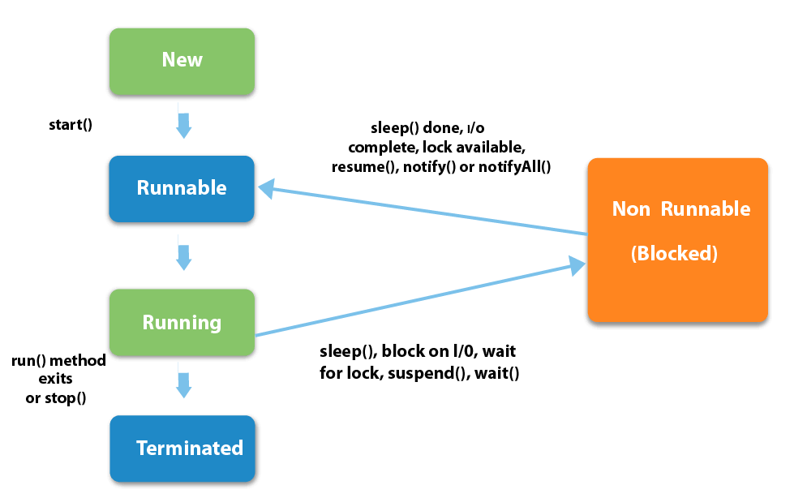
WORKING FLOW

Slide 13
STATES
1) New
The thread is in new state if you create an instance of Thread class but before the invocation of start() method.
2) Runnable
The thread is in runnable state after invocation of start() method, but the thread scheduler has not selected it to be the running thread.
3) Running
The thread is in running state if the thread scheduler has selected it.
4) Non-Runnable (Blocked)
This is the state when the thread is still alive, but is currently not eligible to run.
5) Terminated
A thread is in terminated or dead state when its run() method exits.

Slide 14
How to create thread
There are two ways to create a thread:
1) By extending Thread class
2) By implementing Runnable interface.

Slide 15
Commonly used Constructors of Thread class:
Thread() Thread(String name) Thread(Runnable r) Thread(Runnable r,String name)

Slide 16
Commonly used methods of Thread class:
public void run(): is used to perform action for a thread.
public void start(): starts the execution of the thread. JVM calls the run() method on the thread.
public void sleep(long miliseconds): Causes the currently executing thread to sleep (temporarily cease execution) for the specified number of milliseconds.
public void join(): waits for a thread to die.
public void join(long miliseconds): waits for a thread to die for the specified miliseconds.
public int getPriority(): returns the priority of the thread.
public int setPriority(int priority): changes the priority of the thread.
public String getName(): returns the name of the thread.
public void setName(String name): changes the name of the thread.
public Thread currentThread(): returns the reference of currently executing thread.
public int getId(): returns the id of the thread.
public Thread.State getState(): returns the state of the thread.
public void stop(): is used to stop the thread(depricated)

Slide 17
Naming Thread
The Thread class provides methods to change and get the name of a thread.
By default, each thread has a name i.e. thread-0, thread-1 and so on. By we can change the name of the thread by using setName() method.
The syntax of setName() and getName() methods are given below:
public String getName(): is used to return the name of a thread.
public void setName(String name): is used to change the name of a thread.

Slide 18
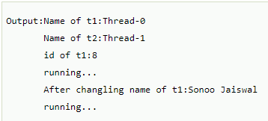
getName(),setName(String) and getId() method:
public String getName()
public void setName(String name)
public long getId()
class TestJoinMethod3 extends Thread{
public void run(){
System.out.println("running...");
}
public static void main(String args[]){
TestJoinMethod3 t1=new TestJoinMethod3();
TestJoinMethod3 t2=new TestJoinMethod3();
System.out.println("Name of t1:"+t1.getName());
System.out.println("Name of t2:"+t2.getName());
System.out.println("id of t1:"+t1.getId());
t1.start();
t2.start();
t1.setName("Sonoo Jaiswal");
System.out.println("After changing name of t1:"+t1.getName());
}
}

Slide 19
The currentThread() method:
The currentThread() method returns a reference to the currently executing thread object.
Syntax:
public static Thread currentThread()
Example of currentThread() method

Slide 20

Example of currentThread() method
class TestJoinMethod4 extends Thread{
public void run(){
System.out.println(Thread.currentThread().getName());
}
}
public static void main(String args[]){
TestJoinMethod4 t1=new TestJoinMethod4();
TestJoinMethod4 t2=new TestJoinMethod4();
t1.start();
t2.start();
}
}

Slide 21
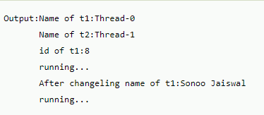
Example of naming a thread
class TestMultiNaming1 extends Thread{
public void run(){
System.out.println("running...");
}
public static void main(String args[]){
TestMultiNaming1 t1=new TestMultiNaming1();
TestMultiNaming1 t2=new TestMultiNaming1();
System.out.println("Name of t1:"+t1.getName());
System.out.println("Name of t2:"+t2.getName());
t1.start();
t2.start();
t1.setName("Sonoo Jaiswal");
System.out.println("After changing name of t1:"+t1.getName());
}
}

Slide 22

Current Thread
The currentThread() method returns a reference of currently executing thread.
public static Thread currentThread()
Example of currentThread() method :
class TestMultiNaming2 extends Thread{
public void run(){
System.out.println(Thread.currentThread().getName());
}
public static void main(String args[]){
TestMultiNaming2 t1=new TestMultiNaming2();
TestMultiNaming2 t2=new TestMultiNaming2();
t1.start();
t2.start();
}
}

Slide 23
Priority of a Thread (Thread Priority):
Each thread have a priority. Priorities are represented by a number between 1 and 10. In most cases, thread schedular schedules the threads according to their priority (known as preemptive scheduling). But it is not guaranteed because it depends on JVM specification that which scheduling it chooses.
3 constants defined in Thread class:
public static int MIN_PRIORITY
public static int NORM_PRIORITY
public static int MAX_PRIORITY
Default priority of a thread is 5 (NORM_PRIORITY). The value of MIN_PRIORITY is 1 and the value of MAX_PRIORITY is 10.

Slide 24
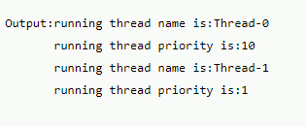
Example of priority of a Thread:
class TestMultiPriority1 extends Thread{
public void run(){
System.out.println("running thread name is:"+Thread.currentThread().getName());
System.out.println("running thread priority is:"+Thread.currentThread().getPriority());
}
public static void main(String args[]){
TestMultiPriority1 m1=new TestMultiPriority1();
TestMultiPriority1 m2=new TestMultiPriority1();
m1.setPriority(Thread.MIN_PRIORITY);
m2.setPriority(Thread.MAX_PRIORITY);
m1.start();
m2.start();
}
}

Slide 25
Runnable interface:
The Runnable interface should be implemented by any class whose instances are intended to be executed by a thread. Runnable interface have only one method named run().
public void run(): is used to perform action for a thread.

Slide 26
Starting a thread:
start() method of Thread class is used to start a newly created thread. It performs following tasks: A new thread starts(with new callstack).
The thread moves from New state to the Runnable state.
When the thread gets a chance to execute, its target run() method will run.

Slide 27

1) Java Thread Example by extending Thread class
class Multi extends Thread{
public void run(){
System.out.println("thread is running...");
}
public static void main(String args[]){
Multi t1=new Multi();
t1.start();
}
}

Slide 28

2) Java Thread Example by implementing Runnable interface
class Multi3 implements Runnable{
public void run(){
System.out.println("thread is running...");
}
public static void main(String args[]){
Multi3 m1=new Multi3();
Thread t1 =new Thread(m1);
t1.start();
}
}
If you are not extending the Thread class,your class object would not be treated as a thread object.
So you need to explicitely create Thread class object.We are passing the object of your class that implements Runnable so that your class run() method may execute.

Slide 29
Thread Scheduler in Java
Thread scheduler in java is the part of the JVM that decides which thread should run.
There is no guarantee that which runnable thread will be chosen to run by the thread scheduler.
Only one thread at a time can run in a single process.
The thread scheduler mainly uses preemptive or time slicing scheduling to schedule the threads.

Slide 30
Difference between preemptive scheduling and time slicing
Pre-emptive scheduling :
The highest priority task executes until it enters the waiting or dead states or a higher priority task comes into existence.
Time slicing :
A task executes for a predefined slice of time and then reenters the pool of ready tasks. The scheduler then determines which task should execute next, based on priority and other factors.

Slide 31
Sleep method in java
The sleep() method of Thread class is used to sleep a thread for the specified amount of time.
Syntax of sleep() method in java :
Two methods for sleeping a thread:
public static void sleep(long miliseconds)throws InterruptedException
public static void sleep(long miliseconds, int nanos)throws InterruptedException

Slide 32
Java Thread Pool
Java Thread pool represents a group of worker threads that are waiting for the job and reuse many times.
In case of thread pool, a group of fixed size threads are created. A thread from the thread pool is pulled out and assigned a job by the service provider. After completion of the job, thread is contained in the thread pool again.

Slide 33
Advantage of Java Thread Pool
Better performance It saves time because there is no need to create new thread.

Slide 34
ThreadGroup in Java
Java provides a convenient way to group multiple threads in a single object. In such way, we can suspend, resume or interrupt group of threads by a single method call.
Java thread group is implemented by java.lang.ThreadGroup class.
A ThreadGroup represents a set of threads. A thread group can also include the other thread group. The thread group creates a tree in which every thread group except the initial thread group has a parent.
A thread is allowed to access information about its own thread group, but it cannot access the information about its thread group's parent thread group or any other thread groups.

Slide 35
A code to group multiple threads
ThreadGroup tg1 = new ThreadGroup("Group A");
Thread t1 = new Thread(tg1,new MyRunnable(),"one");
Thread t2 = new Thread(tg1,new MyRunnable(),"two");
Thread t3 = new Thread(tg1,new MyRunnable(),"three");
Now we can interrupt all threads by a single line of code only.
Thread.currentThread().getThreadGroup().interrupt();

Slide 36
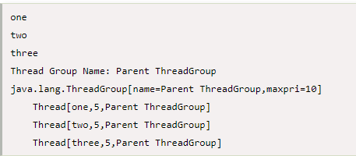
ThreadGroup Example
public class ThreadGroupDemo implements Runnable{
public void run() {
System.out.println(Thread.currentThread().getName());
}
public static void main(String[] args) {
ThreadGroupDemo runnable = new ThreadGroupDemo();
ThreadGroup tg1 = new ThreadGroup("Parent ThreadGroup");
Thread t1 = new Thread(tg1, runnable,"one");
t1.start();
Thread t2 = new Thread(tg1, runnable,"two");
t2.start();
Thread t3 = new Thread(tg1, runnable,"three");
t3.start();
System.out.println("Thread Group Name: "+tg1.getName());
tg1.list();
}
}

Slide 37

Example of sleep method in java
class TestSleepMethod1 extends Thread{
public void run(){
for(int i=1;i<5;i++){
System.out. try{Thread.sleep(500);}catch(InterruptedException e){System.out.println(e);}
println(i);
}
}
public static void main(String args[]){
TestSleepMethod1 t1=new TestSleepMethod1();
TestSleepMethod1 t2=new TestSleepMethod1();
t1.start();
t2.start();
}
}
As you know well that at a time only one thread is executed. If you sleep a thread for the specified time,the thread shedular picks up another thread and so on.

Slide 38
What if we call run() method directly instead start() method?
Each thread starts in a separate call stack.
Invoking the run() method from main thread, the run() method goes onto the current call stack rather than at the beginning of a new call stack.
class TestCallRun1 extends Thread{
public void run(){
System.out.println("running...");
}
public static void main(String args[]){
TestCallRun1 t1=new TestCallRun1();
t1.run();//fine, but does not start a separate call stack
}
}
As you can see in the above program that there is no context-switching because here t1 and t2 will be treated as normal object not thread object.

Slide 39
The join() method
The join() method waits for a thread to die. In other words, it causes the currently running threads to stop executing until the thread it joins with completes its task.
Syntax:
public void join()throws InterruptedException
public void join(long milliseconds)throws InterruptedException

Slide 40
Example of join() method
class TestJoinMethod1 extends Thread{
public void run(){
for(int i=1;i<=5;i++){
try{
Thread.sleep(500);
}catch(Exception e){System.out.println(e);}
System.out.println(i);
}
}
public static void main(String args[]){
TestJoinMethod1 t1=new TestJoinMethod1();
TestJoinMethod1 t2=new TestJoinMethod1();
TestJoinMethod1 t3=new TestJoinMethod1();
t1.start();
try{
t1.join();
}catch(Exception e){System.out.println(e);}
t2.start();
t3.start();
}
}

Slide 41
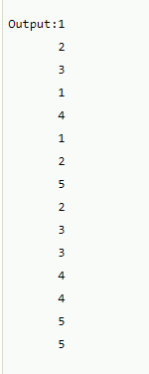
Example of join(long miliseconds) method
class TestJoinMethod2 extends Thread{
public void run(){
for(int i=1;i<=5;i++){
try{
Thread.sleep(500);
}catch(Exception e){System.out.println(e);}
System.out.println(i);
}
}
public static void main(String args[]){
TestJoinMethod2 t1=new TestJoinMethod2();
TestJoinMethod2 t2=new TestJoinMethod2();
TestJoinMethod2 t3=new TestJoinMethod2();
t1.start();
try{
t1.join(1500);
}catch(Exception e){System.out.println(e);}
t2.start();
t3.start();
}
}
In the above example,when t1 is completes its task for 1500 miliseconds(3 times) then t2 and t3 starts executing.

Slide 42
Daemon Thread in Java
Daemon thread in java is a service provider thread that provides services to the user thread. Its life depend on the mercy of user threads i.e. when all the user threads dies, JVM terminates this thread automatically.
There are many java daemon threads running automatically e.g. gc, finalizer etc.

Slide 43
Points to remember for Daemon Thread in Java
It provides services to user threads for background supporting tasks. It has no role in life than to serve user threads.
Its life depends on user threads.
It is a low priority thread.

Slide 44
Why JVM terminates the daemon thread if there is no user thread?
The sole purpose of the daemon thread is that it provides services to user thread for background supporting task. If there is no user thread, why should JVM keep running this thread. That is why JVM terminates the daemon thread if there is no user thread.

Slide 45

Simple example of Daemon thread in java
public class TestDaemonThread1 extends Thread{
public void run(){
if(Thread.currentThread().isDaemon()){//checking for daemon thread
System.out.println("daemon thread work");
}
else{
System.out.println("user thread work");
}
}
public static void main(String[] args){
TestDaemonThread1 t1=new TestDaemonThread1();//creating thread
TestDaemonThread1 t2=new TestDaemonThread1();
TestDaemonThread1 t3=new TestDaemonThread1();
t1.setDaemon(true);//now t1 is daemon thread
t1.start();//starting threads
t2.start();
t3.start();
}
}

